Slide 1








EMPOWERING THE NEXT GENERATION OF PHYSICIANS
Future Physicians
for Change
April 17-19 2025
Washington DC

Slide 2


In Washington DC
April 17 - 19,
catch 3 inspired days of
future
physician
empowerment
Residency & Specialty Fair
Pre-Health Fair
Advocacy on Capitol Hill in DC
Poster Presentations
SIM Competition

Slide 3

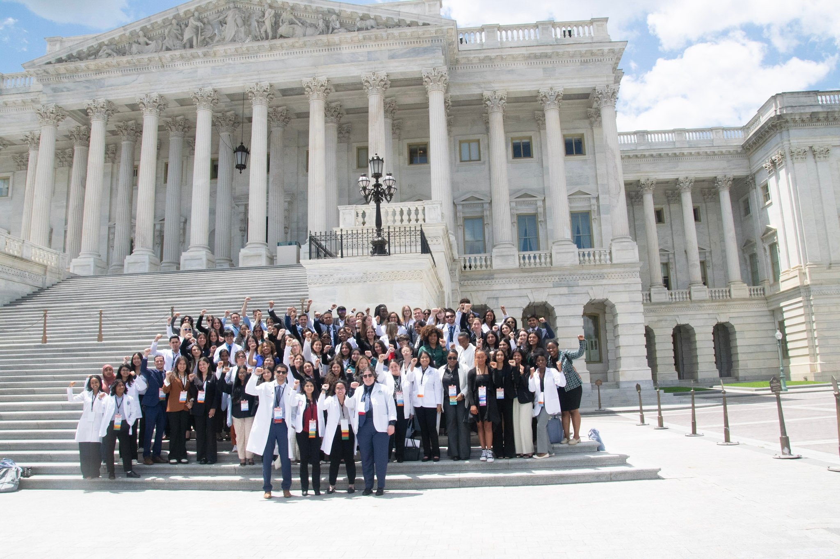



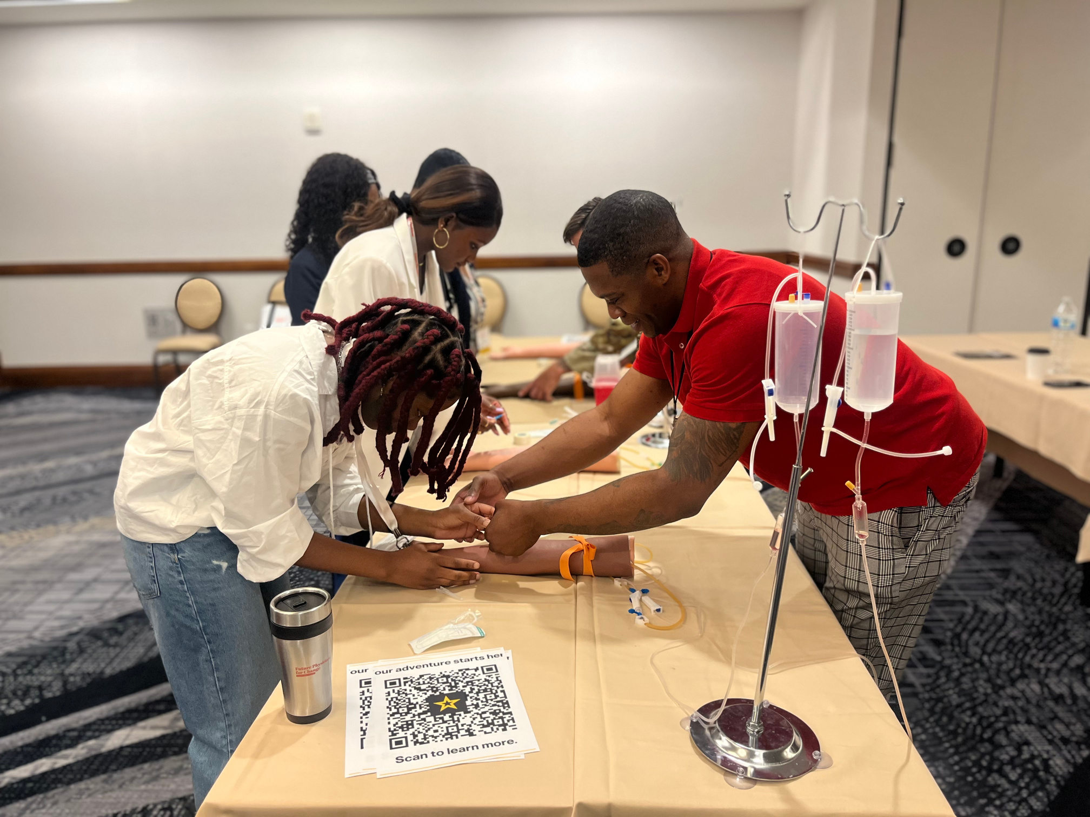

Highlights
Advocacy training & experience
Poster session &
awards
Leadership
development
Togetherness, networking, community
Clincal skill building
SIM competition
Let’s Go!
The ride to DC is on —
see what all the excitement is about & jack in!

Slide 4



Future Physicians
for Change
April 17-19 2025
Washington DC
fp4change.org
Don’t miss the
th
75
annual

